Slide 1
12.10.2023, Hotel Palisad, Zlatibor,
CCM 2023
Advances in understanding of technologies for treatment of critical minerals
Srecko Stopic, Christian Dertmann, Bernd Friedrich

Slide 2
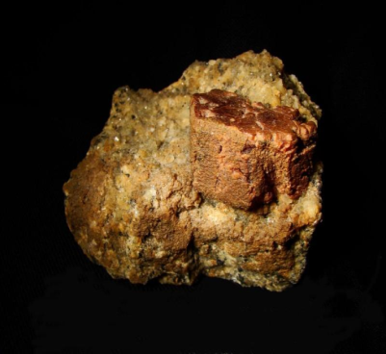
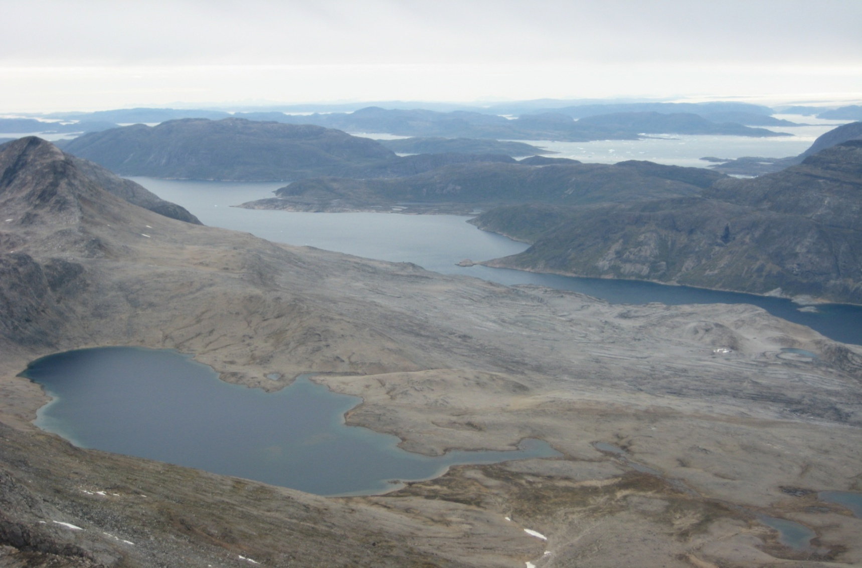
Critical Minerals
Mineral | Chemical composition in ore
Bastnäsit | (Ce, La, Y)CO₃F
Monazit | (Ce,La,Nd,Th)PO₄
Xenotim | YPO₄
Eudialyt | Na₁₅Ca₆(Fe,Mn)₃Zr₃SiO(O,OH,H₂O)₃ (Si₃O₉)₂(Si₉O₂₇)₂(OH,Cl)₂
Fosters Lake
Grönland

Slide 3
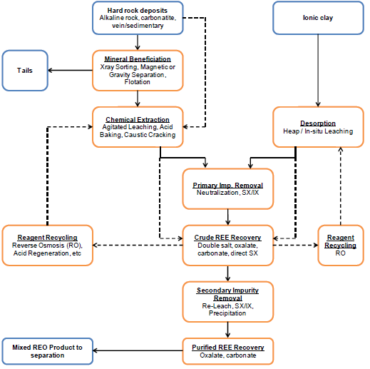
Generic REE conceptual flowsheet
N. Verbaan et al. (2015)
A review of hydrometallurgical flowsheets considered in REE.
Current projects
Symposium on critical and strategic materials
British Colombia Geological Survey paper

Slide 4
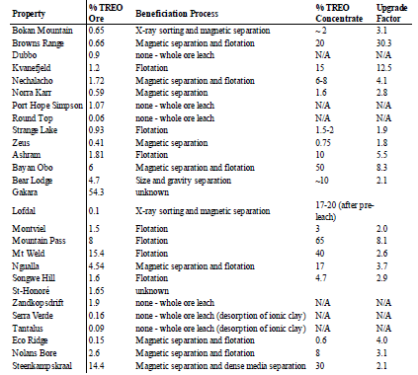
Benefication Process

Slide 5
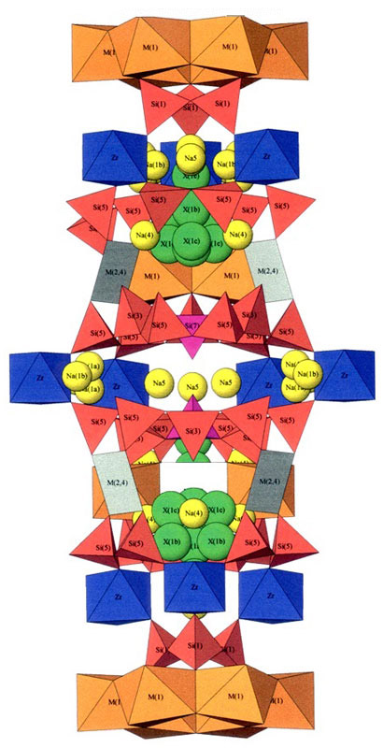
Chemical composition of eudialyte ore, Grönland
Elements | Si | Al | Fe | Ca | Na | K | Ti | Mn | Nb | Zr | TREE
wt.% | 23.1 | 3.2 | 6.0 | 5.7 | 9.9 | 0.8 | 0.2 | 0.3 | 0.1 | 6.5 | 1.6
Eudialyte is a Na-rich zirconosilicate with constant amount of elements including REE.
Na₁₅Ca₆Fe₃Zr₃Si(Si₂₅O₇₅)(O,OH,H₂O)₃(Cl,OH)₃

Slide 6
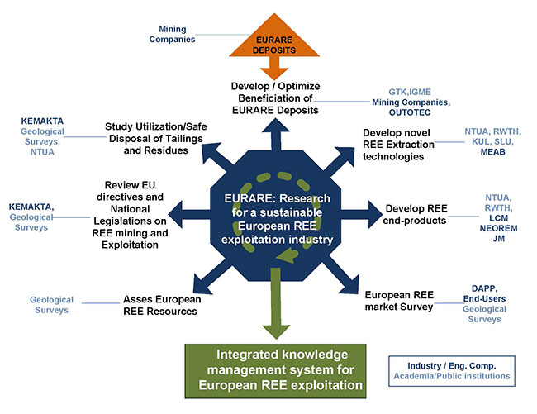
About the EURARE Program

Slide 7
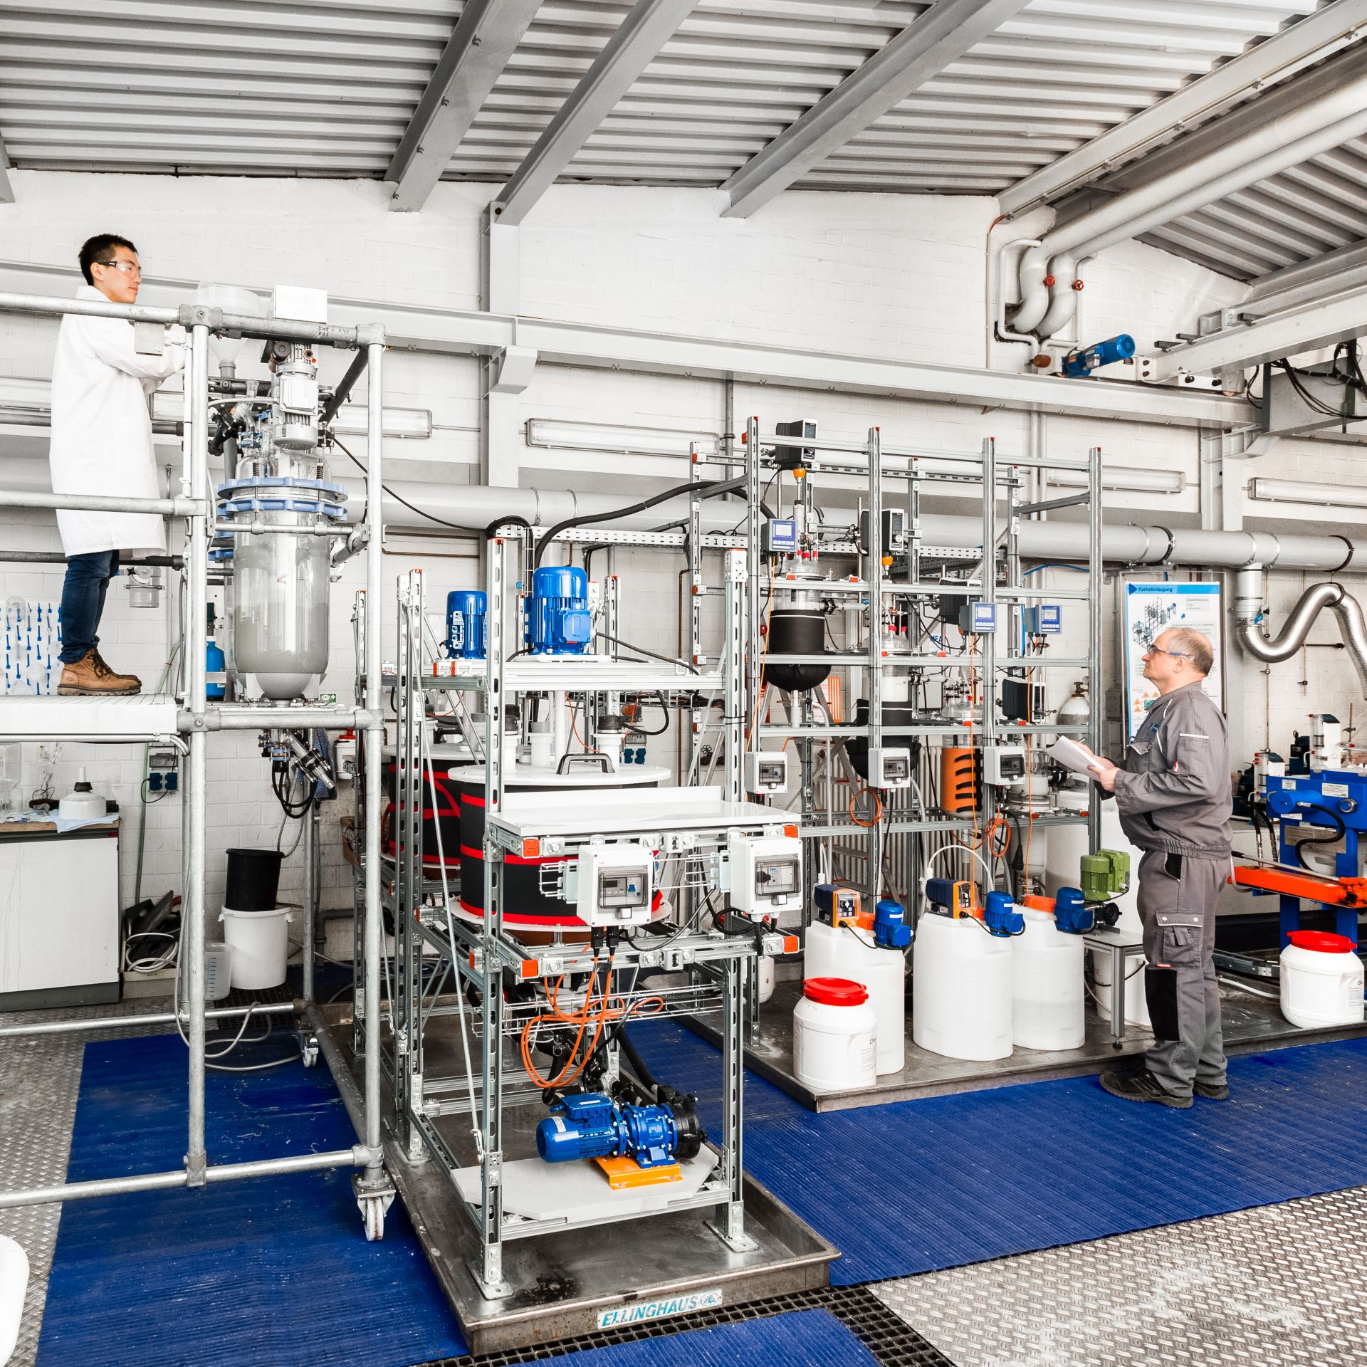
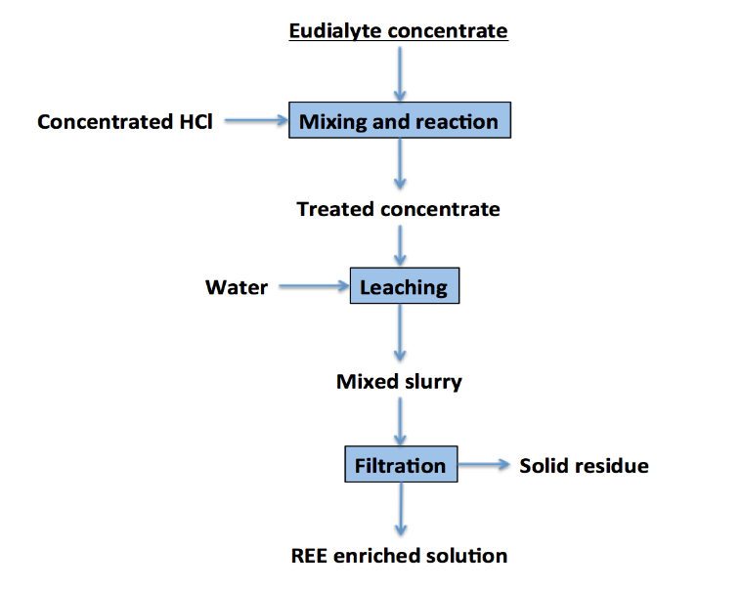
Demonstration plant for production of rare earth carbonate
Variable | Minimum | Mean | Maximum
Concentrate: HCl/ (kg/L) | 1: 1 | 1: 1.25 | 1: 1.5
Concentrate: Water/ (kg/L) | 1: 1 | 1: 2 | 1: 3
Leaching Temperature/ ℃ | 20 | 50 | 80
Reaction time/ min | 20 | 40 | 60
Y.Ma, S.Stopic, B.Friedrich,
Hydrometallurgical Treatment of a Eudialyte Concentrate for Preparation of Rare Earth Carbonate, Johnson Matthey Technology Review, January 2019, 8
Y. Ma, S.Stopic, L.Gronen, S.Obradovic, M.Milivojevic, B.Friedrich, Neural Network Modeling
for the Extraction of Rare Earth Elements from Eudialyte Concentrate by
Dry Digestion and Leaching, Metals, 2018, 8 (4), 267

Slide 8
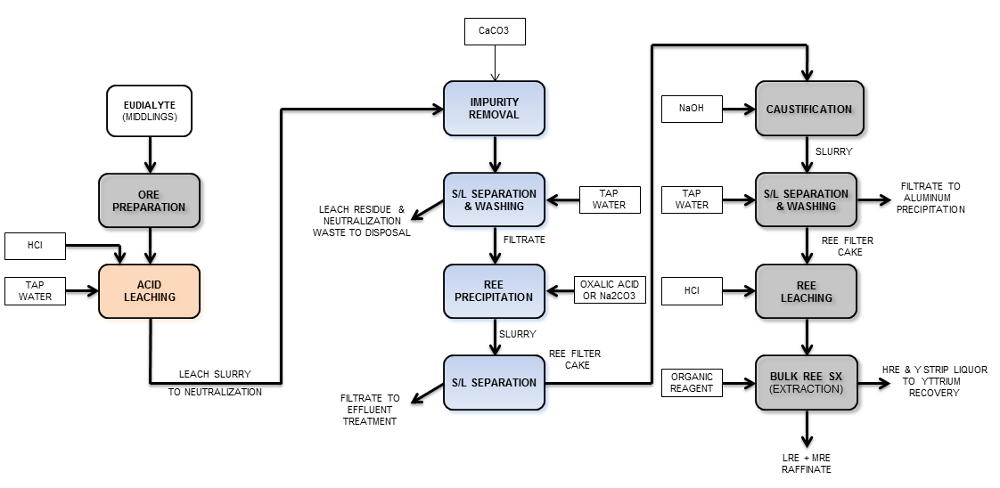
Initial IME/MEAB Strategy for REE ore treatment

Slide 9
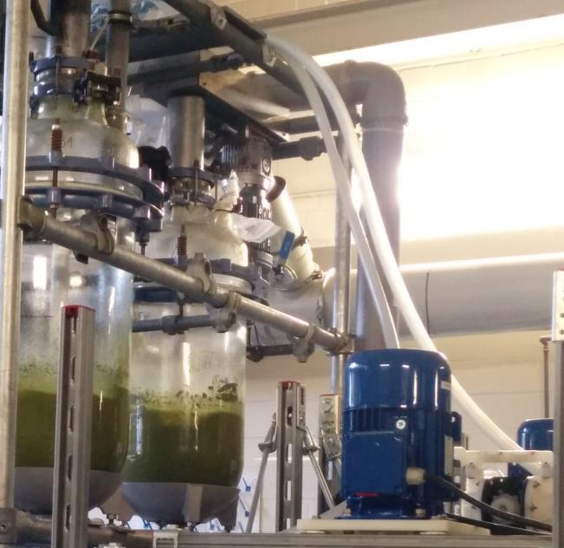
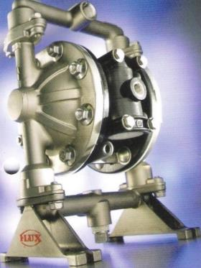
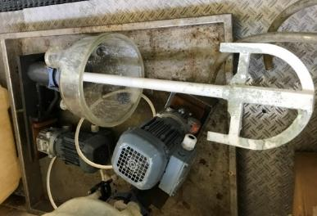
Dry digestion process (fuming) - the heart of this process
Characteristics:
Average treatment rate (kg/hour): 6
Reactor volume (L): 40
Digestion media HCl, 31% (L): 6-7.2
Washing media H₂O (L): 18-24
Dry digestion time (min): 45
Washing time (min): 15
Temperature: 20°C, due to exothermic effect increase to 60-70 °C
Flux- air operated diafragm pump
Flow rate (30 L/min)
Operated pressure

Slide 10
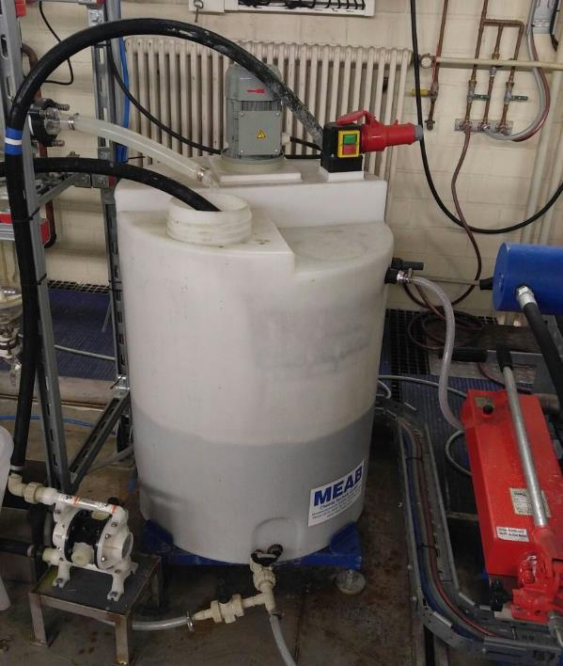
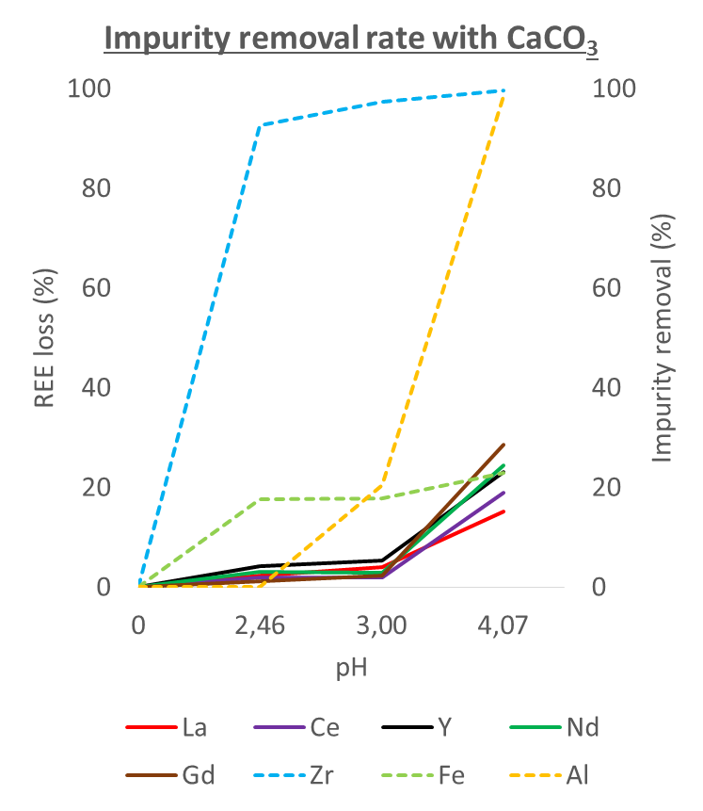
pH adjustment using CaCO₃ (Norra Kärr-Sweden and Tanbarez-Grönland)
At pH 4 (first stage of leach purification), mainly Fe transferred to the residue, while REEs remain in solution

Slide 11
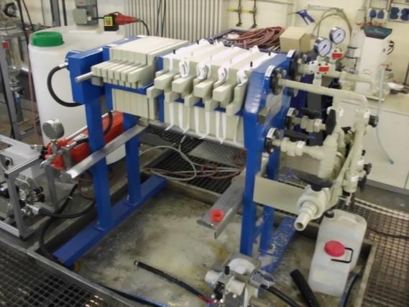
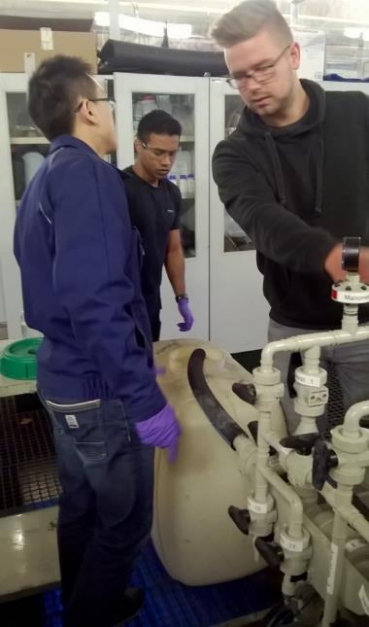
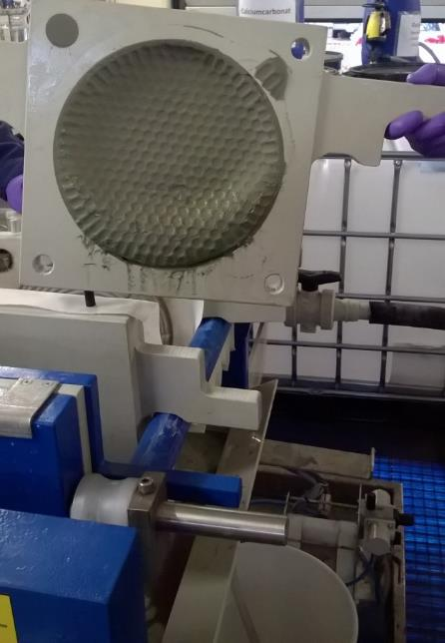
Filtration using a semi-continuous chamber filter press
pH of solution smaller than 4.0-4.1
Max pressure: 6 bar
Flow rate of suspension: 1-1.2 L/min

Slide 12
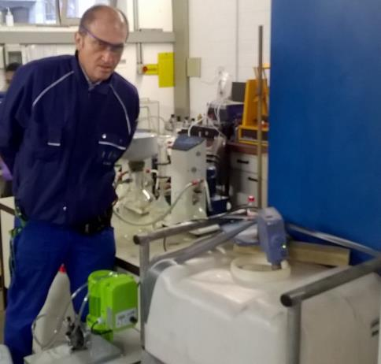
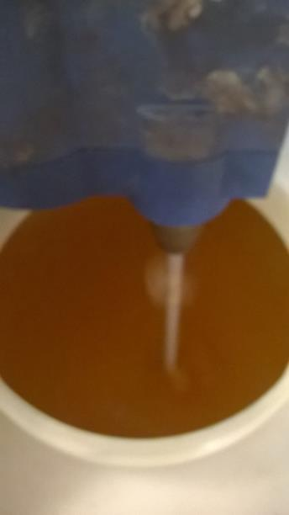
REE precipitation efficiency with Na₂CO₃
After precipitation with sodium carbonate, more than 95 % of REEs transferred to REE-carbonate

Slide 13
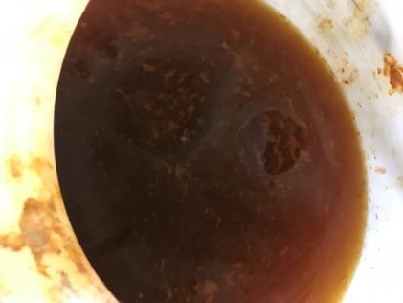
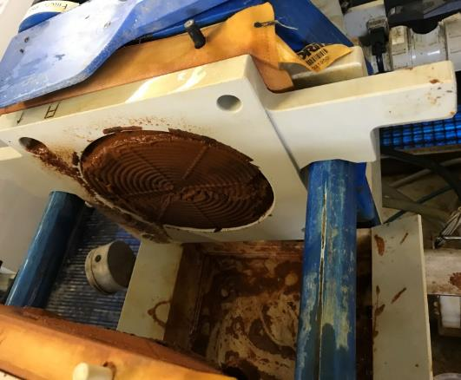
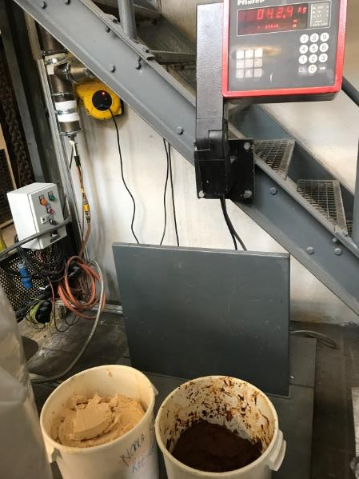
Removal of iron from the produced REE-Carbonate
REE carbonate re-dissolved with HCl
With NaOH a second precipitation was performed
Oxidation of Fe(II) to Fe(III) using 4 ml 30 % H₂O₂/1 L solution
pH value adjusted using diluted NaOH to pH 3.5 to 3.8
Need of flocculants, filtration

Slide 14
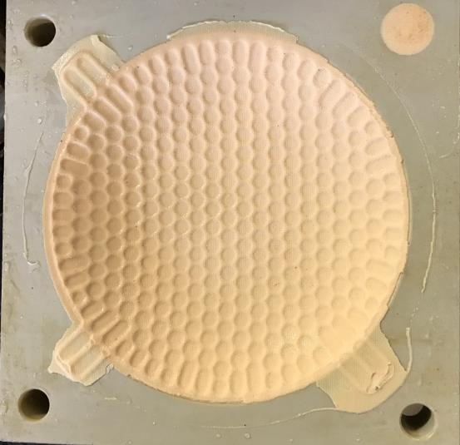
Produced REE carbonate (31 % REE)
 | La | Ce | Nd | Tb | Gd | Y | Sm | Dy | Eu
 | % | % | % | % | % | % | % | % | %
REE carbonate | 5,23 | 10,5 | 3,90 | 0,20 | 0,85 | 7,15 | 0,93 | 1,17 | 0,08
 | He | Sc | Fe | Al | Zr | Na | Ca | Mn | Si
 | % | % | % | % | % | % | % | % | %
REE carbonate | 0,78 | <0,01 | 0,20 | 3,31 | 0,05 | 4.43 | 4,18 | 0,23 | 0.03

Slide 15
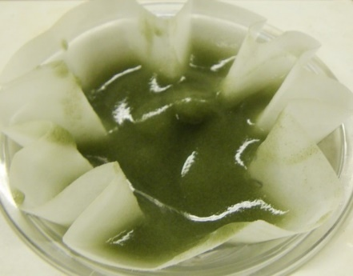
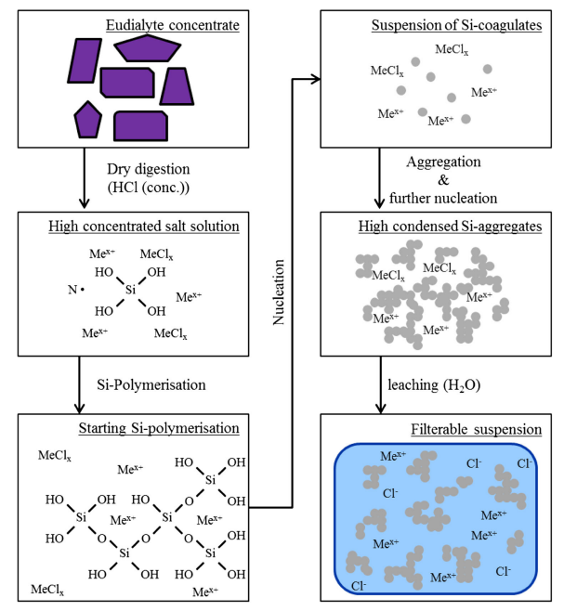
Recovery of rare earth elements from eudialyte, nickel lateritic ore and red mud
Duration: 01.04.2019-31.12.2021, ZIM AIF- Financial support, Germany (MAREKO Project)
Title: Development of a modular reactor for the dry digestion of high silicon-rich ores and concentrates to avoid gel formation using the example of eudialyte concentrates
Konsortium: IME, RWTH Aachen, Germany and Konzept GmbH, Germany
filterable silica coagulate
D. Vosenkaul, B.Friedrich,..
J. Sustain. Metall. (2017) 3:79–89
MeSiO₃ + H₂O + 2 HCl = Si(OH)₄ + MeCl₂

Slide 16
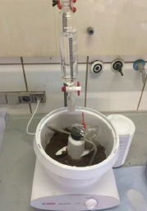
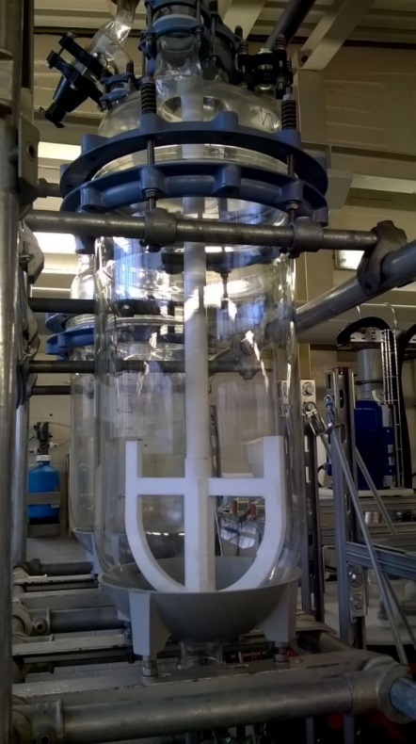
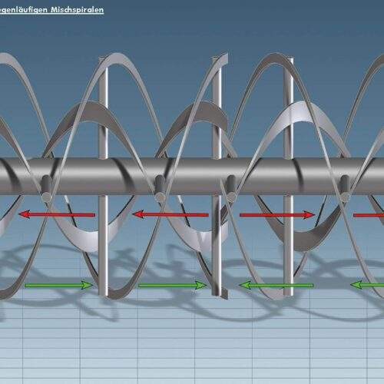
Development of Dry digestion reactor for dissolution of ores
Improvement:
Countercurrent flow mixing system
Separated acid and water injection
Large volume
Higher ore charging
Corrosion resistance materials
2L reactor
(Maximal charging- 1 kg)
40L Reactor (EURARE)
(maximal charging 10 kg)

Slide 17
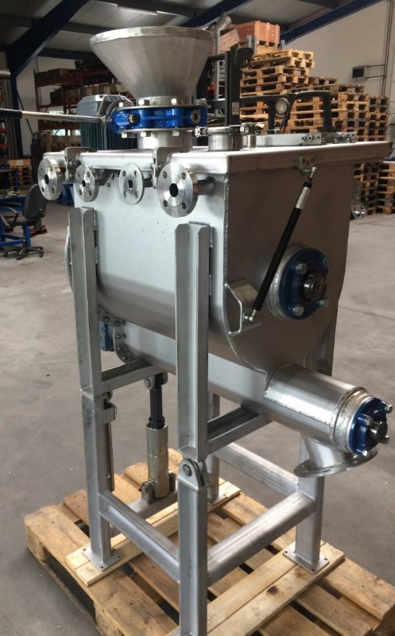
Dry digestion reactor, konzept GmbH, Germany
Characteristics of reactor:
Volumen (L): 100
Weight of solid (kg): 40
Manual injection of solid materials
Nozzle system for water and acid injection
Countercurrent flow mixing system
No heating in reactor
High concentration of acid (<10 mol/L) enables a strong exothermic reaction
After the mixing process, the leached product leaves the mixing chamber through the outlet flaps
With permission of Konzept, Düren, Germany

Slide 18
Chemical composition of studied materials with reaction parameters
Eudialyte
Main aims:
High leaching efficiency of REE
Avoiding of the silica gel formation
Al | Fe | Ti | Ca | Si | Zr | Mn | La | Ce | Y | Nd
% | % | % | % | % | % | % | ppm | Ppm | ppm | ppm
8,92 | 3,62 | 0,13 | 1,59 | 25,1 | 0,77 | 0,14 | 554 | 1400 | 897 | 650
.
Bauxite residue
Al | Fe | Ti | Ca | Si | Sc | V | Ce | Y
% | % | % | % | % | ppm | ppm | Ppm | ppm
13,90 | 6,14 | 4,47 | 9,29 | 18,1 | 108 | ´429 | 462 | 124
Parameter | Unit | Value
Initial Material | kg | 20
Used acid | - | 96% H₂SO₄
concentration | mol/l | 12
Duration of dry digestion | min | 120
Solid /liquid in dry digestion (H₂SO₄) | - | 1:2
Solid/liquid in leaching (H₂O) | - | 1:5
Duration of leaching | min | 60
Lateritic oxidic ores
Al | Fe | Ti | Cr | Si | Ni | V | Sc | Y
% | % | % | % | % | % | ppm | ppm | ppm
1,13 | 29,80 | 0,02 | 0,57 | 16,7 | 1,68 | 61 | 47 | 4

Slide 19
Dry digestion of Eudialyte and Bauxite residue
High leaching efficiency for La, Ce, Nd and Y higher than 90 %.
High leaching efficiency for Y and La and Mn

Slide 20
Dry digestion of the nickel lateric ore from Turkey
High leaching efficiency for Ti (about 100 %), 60 % V, 50 % Ni, 45 % Sc and minimal dissolution of silicon.
Sample | Eudialyte | Red Mud | Ni-Laterite
Initial mass (kg) | 20,00 | 20,00 | 20,00
Si in initial mass (g) | 5020,00 | 770,00 | 3338,26
C_{Si} in Solution (mg/L) | 101,3 | 120,75 | 31,75
Si in solution (g) | 10,13 | 12,08 | 3,18
Efficiency (%) | 0,20 | 1,57 | 0,10

Slide 21
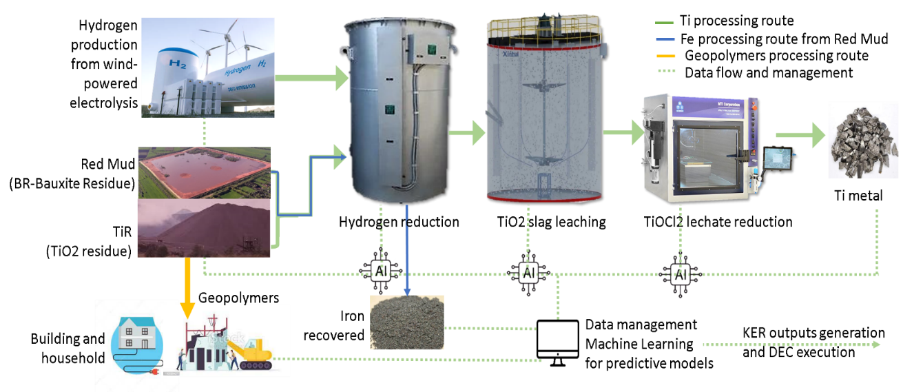
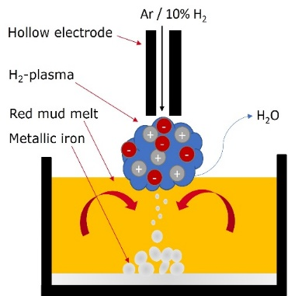
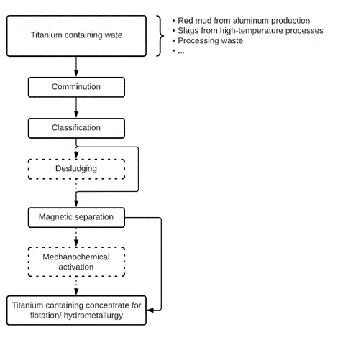
EURO-TITAN (01.01.2024-31.12.2027)
Technical University Clausthal, Germany (Coordinator)
Other Participants:
RWTH-Aachen
ALUMINA, Zvornik
Technological Faculty, Zvornik
Private companies from Greece, Germany, France)
Hydrogen-Plasma reduction of industrial wastes

Slide 22
Summary
Future development in rare earth metallurgy needs the new raw materials, applications, and technology.
Processing of ores produces the concentrates with different content of rare earths.
The most used minerals in production of rare earths: Bastnäsite, Xenotime, Eudialyte, Monazite.
The applied hydrometallurgical processes (leaching, filtration and precipitation) result in the production of rare earth carbonate.
After the thermal cracking of rare earth carbonate, the rare earth oxide were produced
Technical innovations are changing demand behavior and causing commodity markets to become unbalanced.

Slide 23
sstopic@ime-aachen.de

